Slide 1
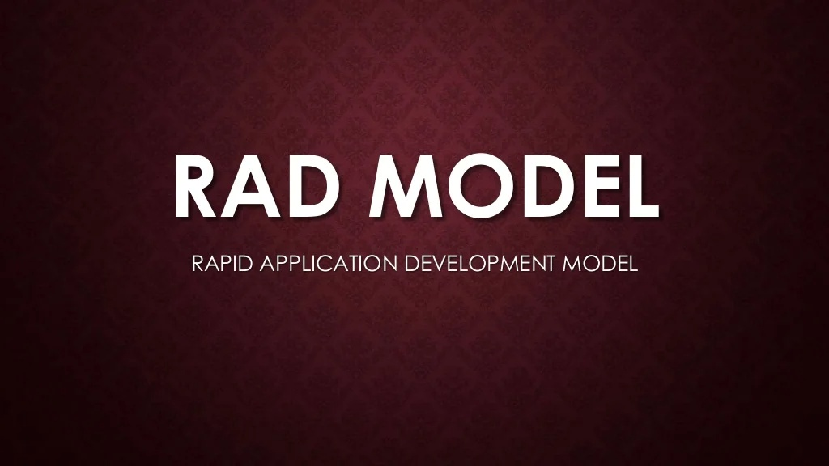

Slide 2
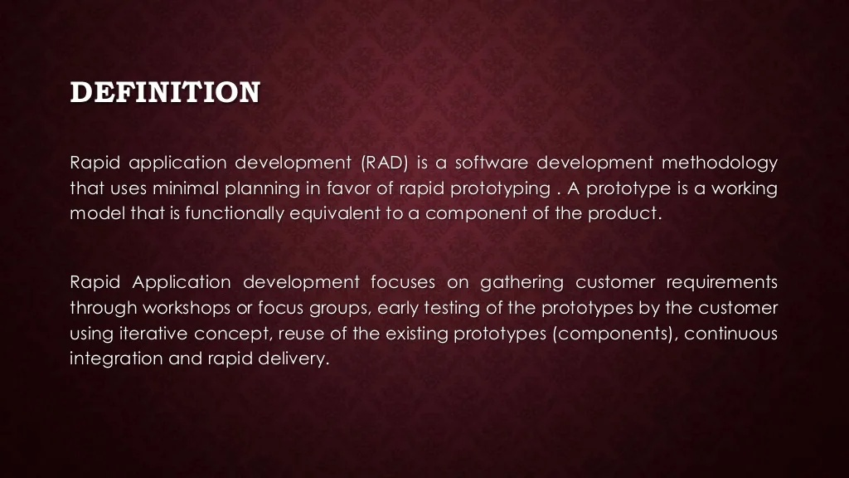

Slide 3
The Rapid Application Development Model was first proposed by IBM in the 1980s.
The critical feature of this model is the use of powerful development tools and techniques.
A software project can be implemented using this model if the project can be broken down into small modules wherein each module can be assigned independently to separate teams. These modules can finally be combined to form the final product.
Development of each module involves the various basic steps as in the waterfall model i.e analyzing, designing, coding, and then testing, etc. as shown in the figure.
Another striking feature of this model is a short time span i.e the time frame for delivery(time-box) is generally 60-90 days.

Slide 4
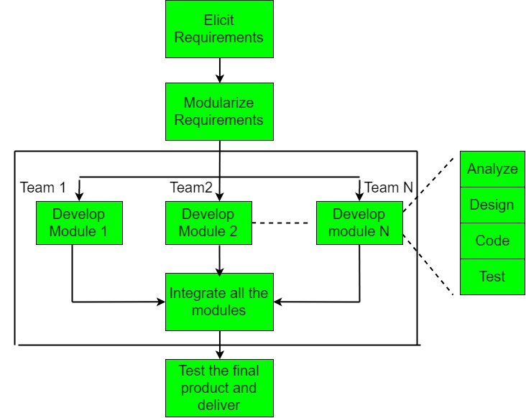

Slide 5
The use of powerful developer tools such as JAVA, C++, Visual BASIC, XML, etc. is also an integral part of the projects. This model consists of 4 basic phases:
Requirements Planning – It involves the use of various techniques used in requirements elicitation like brainstorming, task analysis, form analysis, user scenarios, FAST (Facilitated Application Development Technique), etc. It also consists of the entire structured plan describing the critical data, methods to obtain it, and then processing it to form a final refined model.
User Description – This phase consists of taking user feedback and building the prototype using developer tools. In other words, it includes re-examination and validation of the data collected in the first phase. The dataset attributes are also identified and elucidated in this phase.
Construction – In this phase, refinement of the prototype and delivery takes place. It includes the actual use of powerful automated tools to transform process and data models into the final working product. All the required modifications and enhancements are too done in this phase.

Slide 6
4. Cutover – All the interfaces between the independent modules developed by separate teams have to be tested properly. The use of powerfully automated tools and subparts makes testing easier. This is followed by acceptance testing by the user.

Slide 7
When to use RAD Model
When the customer has well-known requirements, the user is involved throughout the life cycle, the project can be time boxed, the functionality delivered in increments, high performance is not required, low technical risks are involved and the system can be modularized.
In these cases, we can use the RAD Model.

Slide 8
When to use RAD Methodology?
When a system needs to be produced in a short span of time (2-3 months)
When the requirements are known
When the user will be involved all through the life cycle
When technical risk is less
When there is a necessity to create a system that can be modularized in 2-3 months of time
When a budget is high enough to afford designers for modeling along with the cost of automated tools for code generation

Slide 9
RAD Model or Rapid Application Development model is a software development process based on prototyping without any specific planning. In RAD model, there is less attention paid to the planning and more priority is given to the development tasks. It targets at developing software in a short span of time.
SDLC RAD modeling has following phases
Business Modeling
Data Modeling
Process Modeling
Application Generation
Testing and Turnover

Slide 10
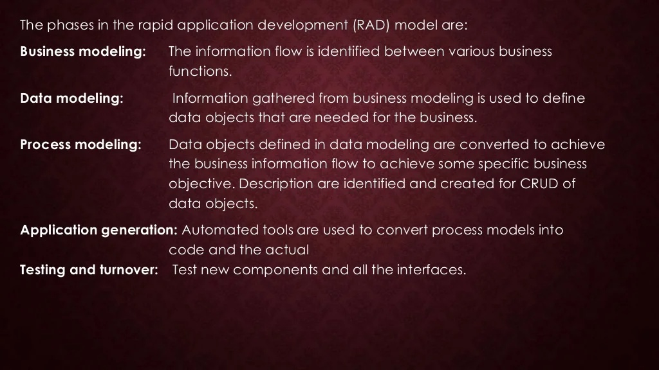

Slide 11
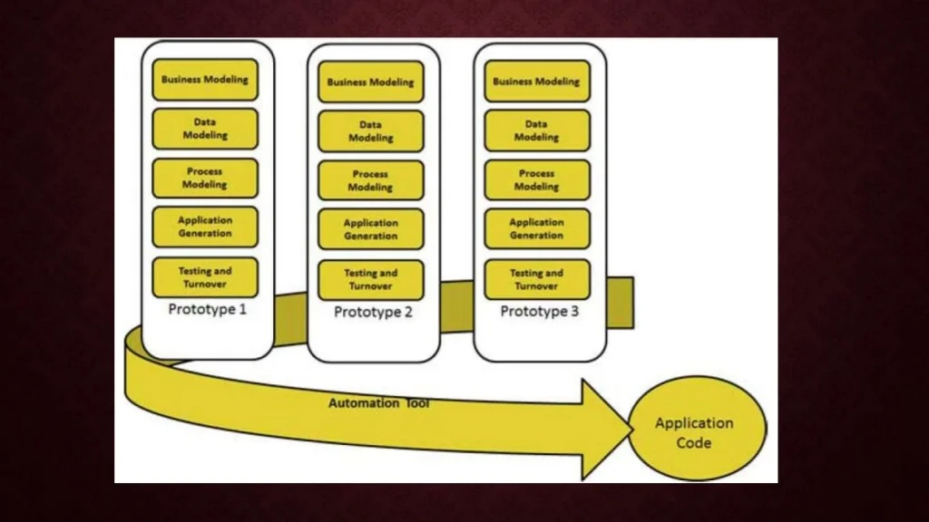

Slide 12
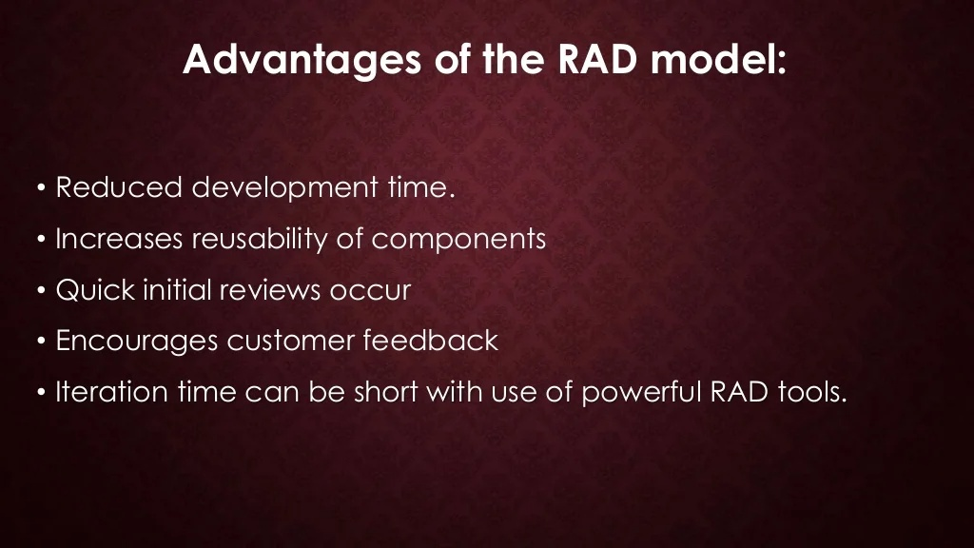

Slide 13
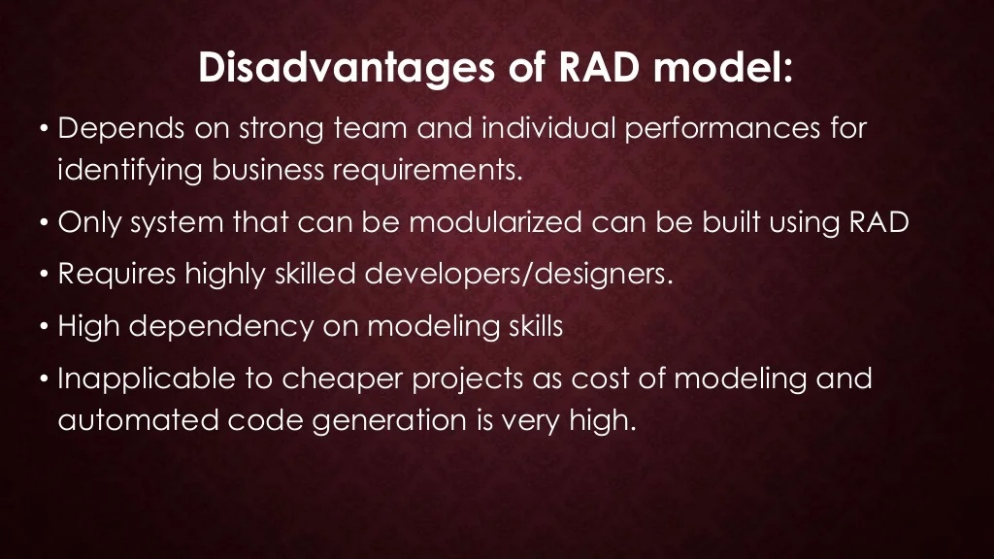

Slide 14
